Slide 1


Research Topic 2
A usable spatial data publication platform
Teun van Sprundel
Matthew Pegels
Notes:
00:00 01:00 Welcome
Welcome
My name is Teun van Sprundel and this is my colleague Matthew Pegels.
We are working at Spotzi BV.
Today we’re giving a presentation about our topic in the geonovum research:
A usable spatial data publication platform
We will show you what we’ve been doing in de past two months for this project and will demo some of our results so far

Slide 2
Content of the presentation
About Spotzi
Who is Spotzi? What are our business activities?
Topic 2
Explanation of our testbed topic
Tasks of the study
User management
Different kind of users
Authorization
Easy to use
Workflows and toolchains
Searchable data
Linking data
Linking to non-geo data
Linking to formal definitions
Versioning
Notes:
01:00 02:00 Content
Content of the presentation:
Spotzi
Topic 2
Our tasks:
User management
Workflows and toolchains
Searchable data
Linking data

Slide 3


FIND, ANALYZE AND VISUALIZE LOCATION DATA.
1 + 1 = 2
ANALYSING
Notes:
3 02:00 03:00 Spotzi
Spotzi
Find
Analyze
Visualize

Slide 4
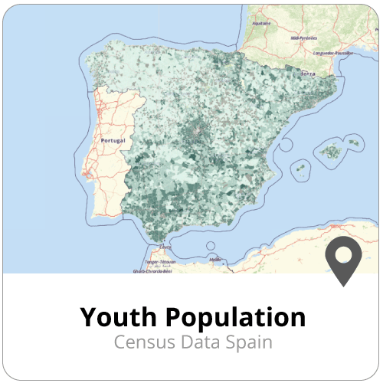
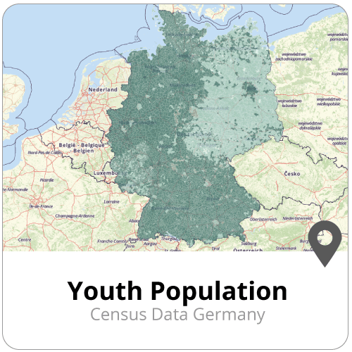
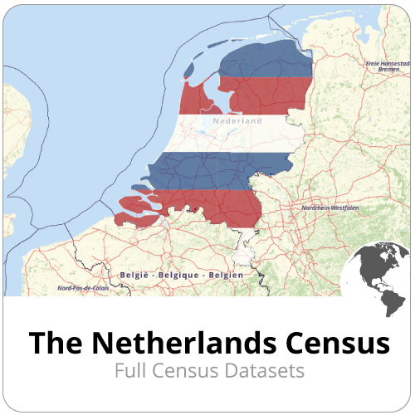
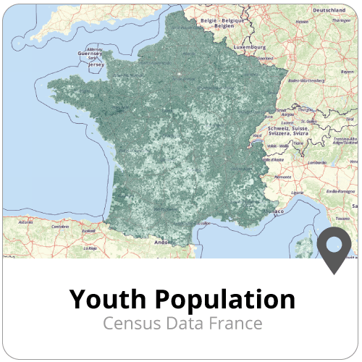
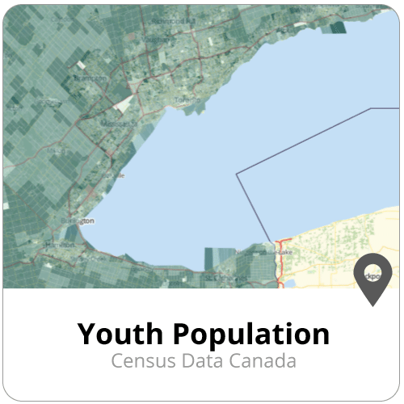
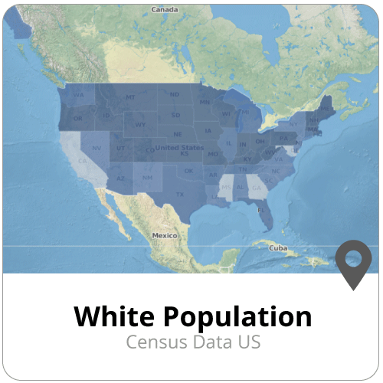
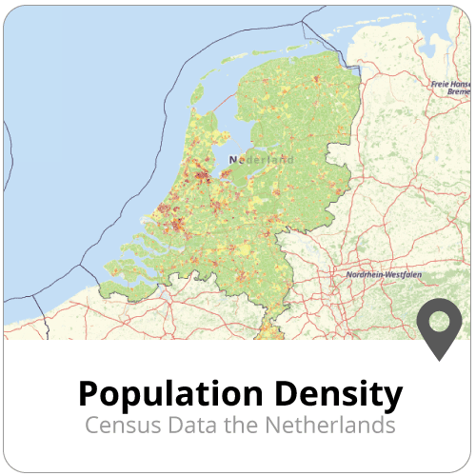
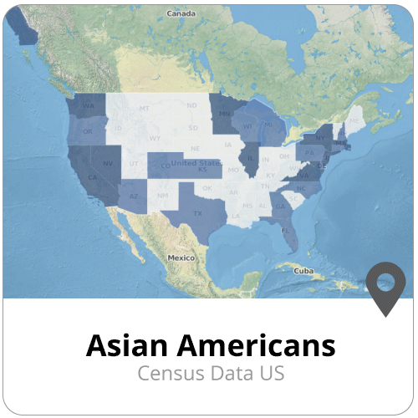
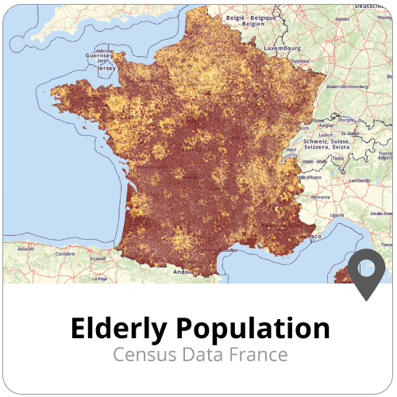
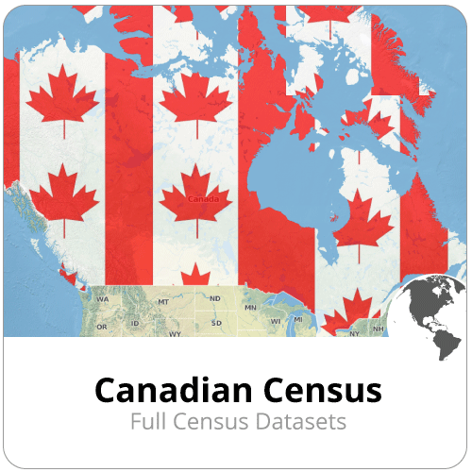
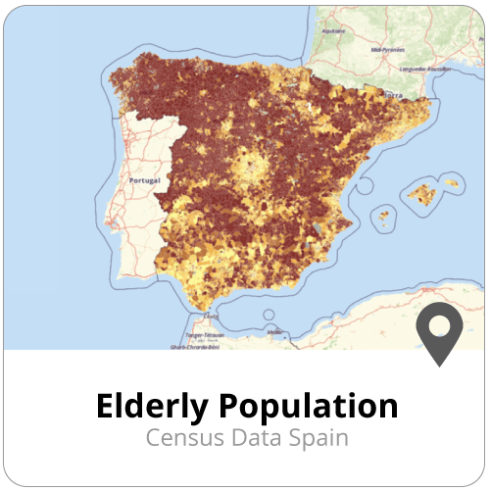
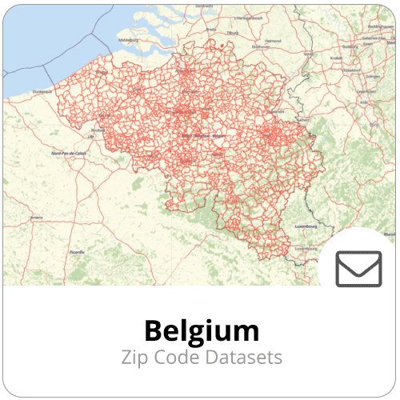
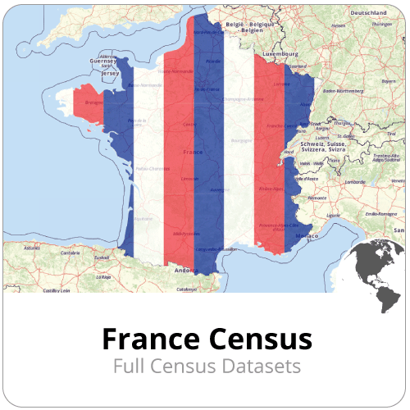
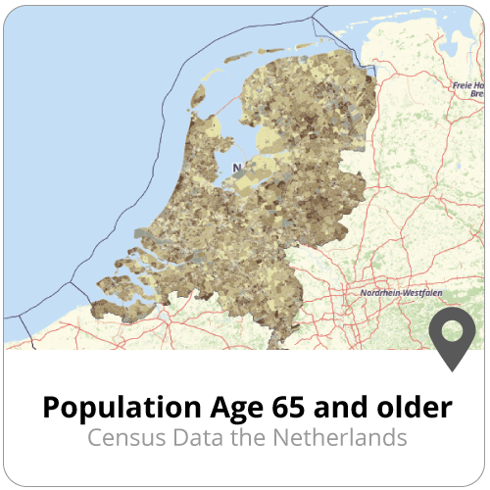
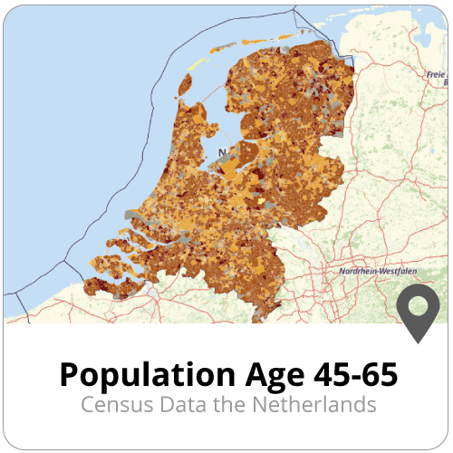
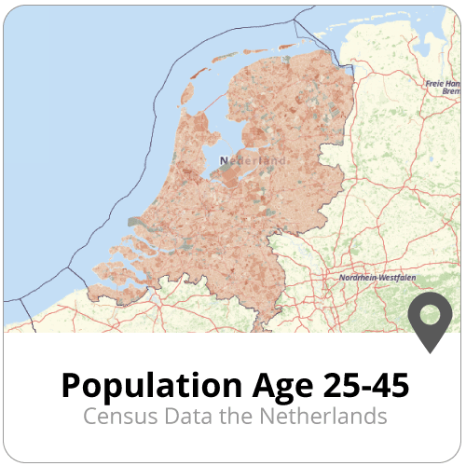
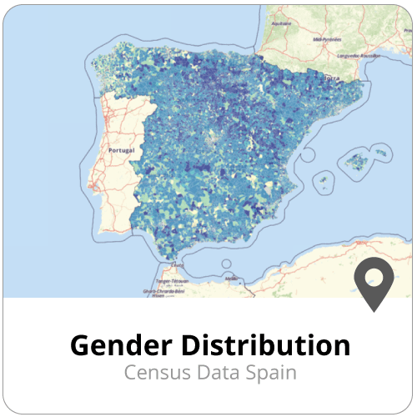
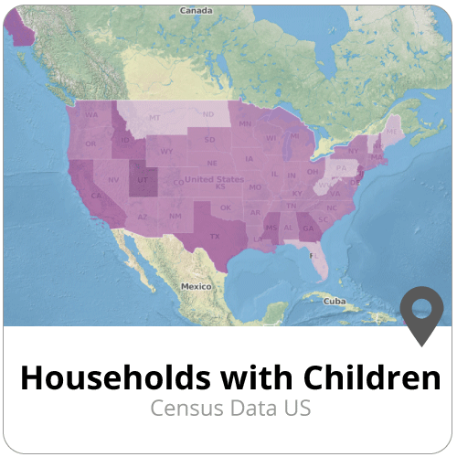
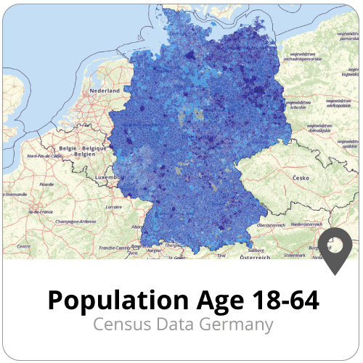
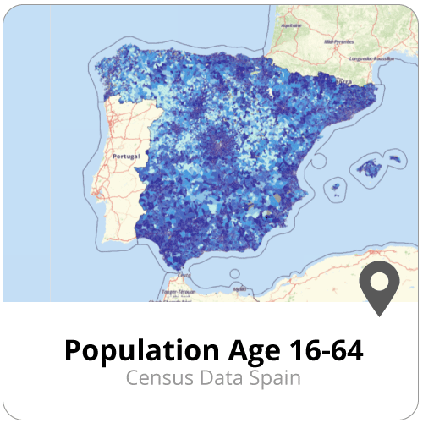
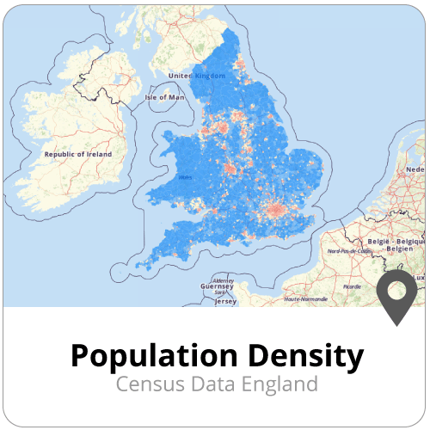
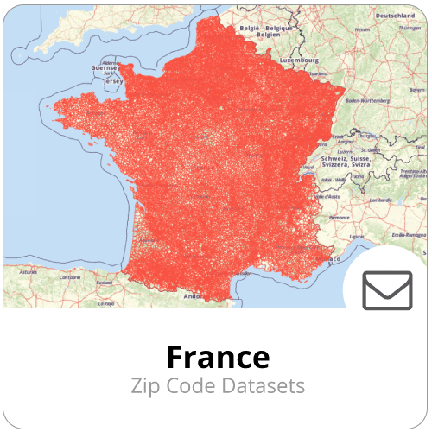
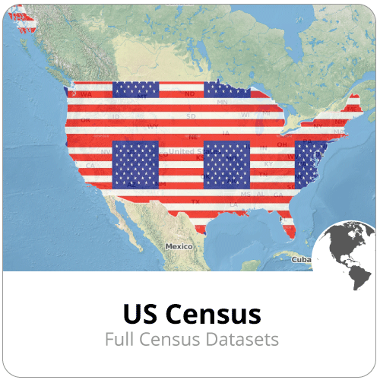
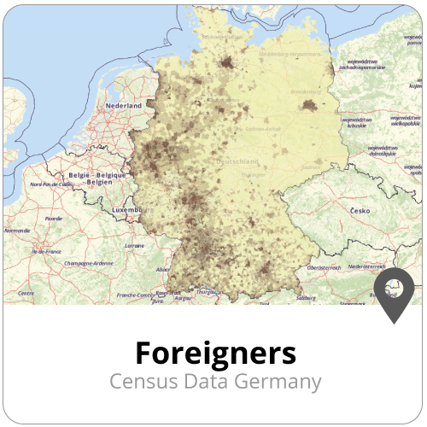
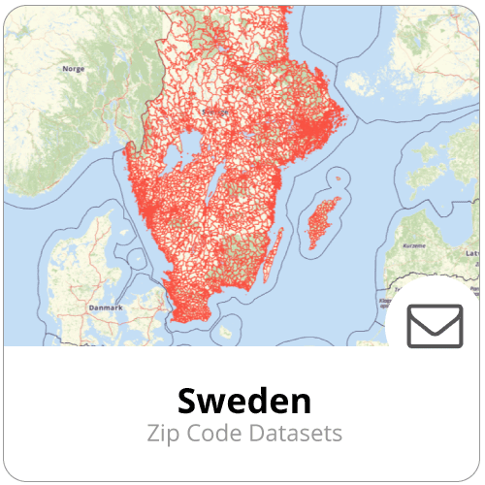
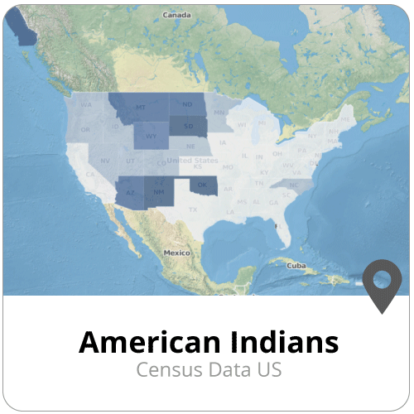
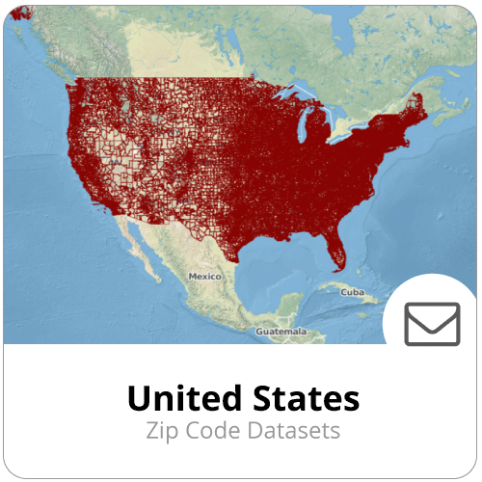
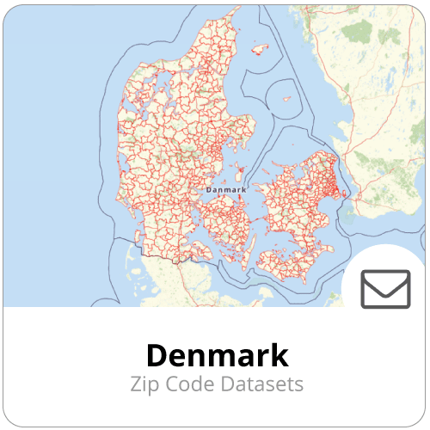
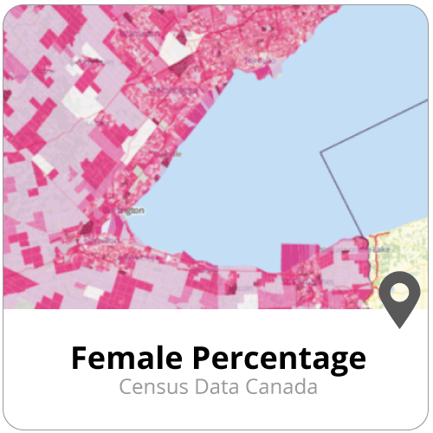
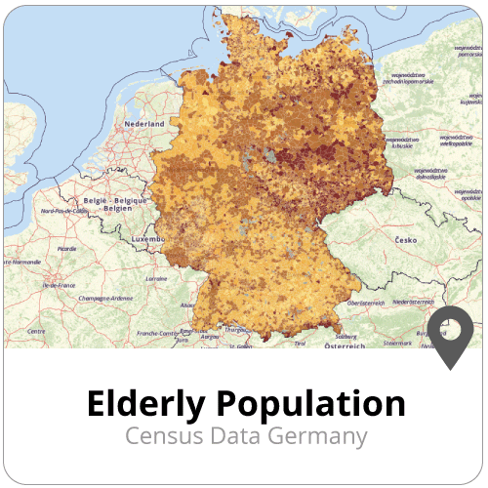
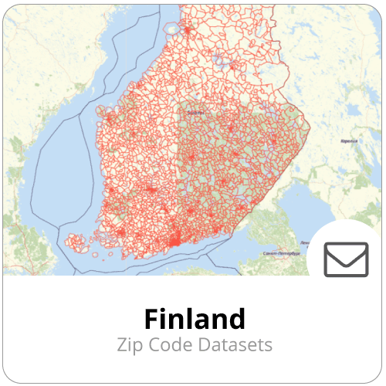
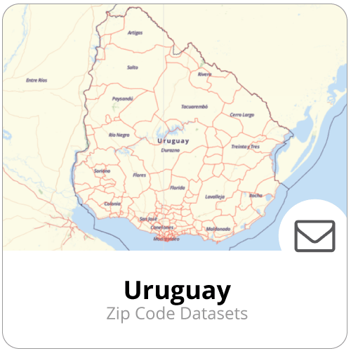
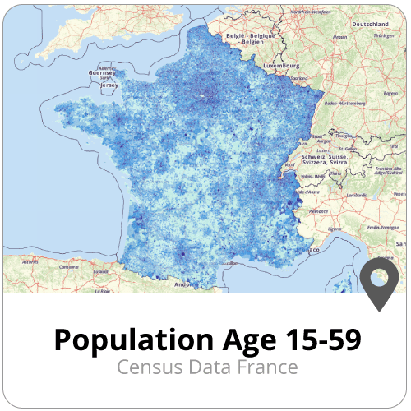
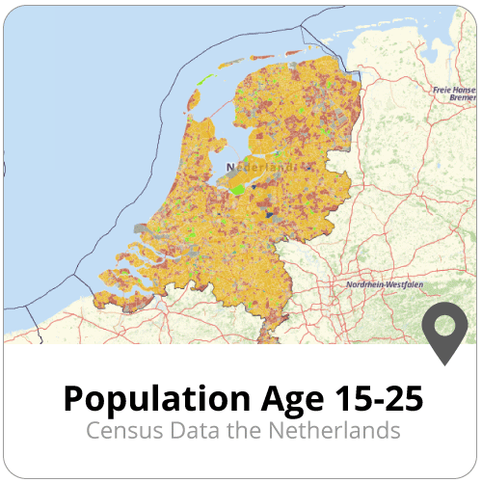
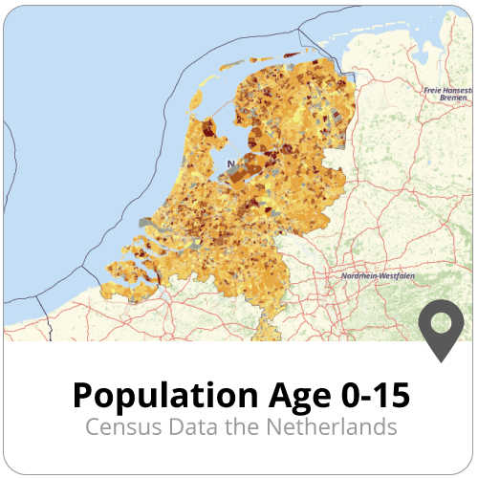
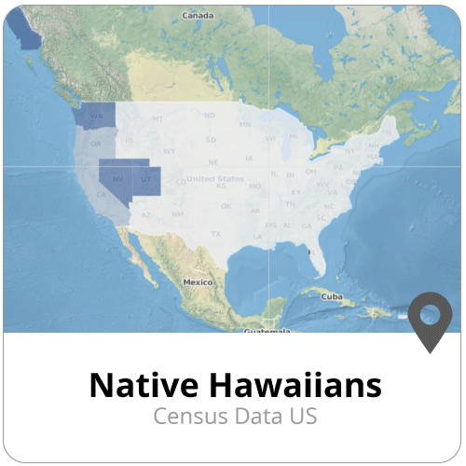
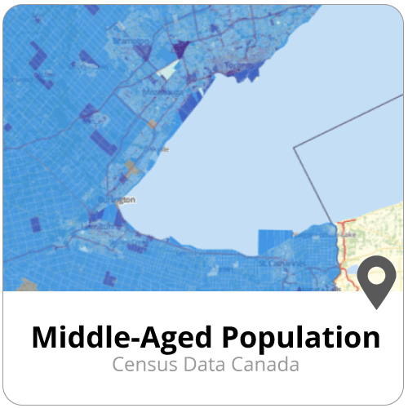
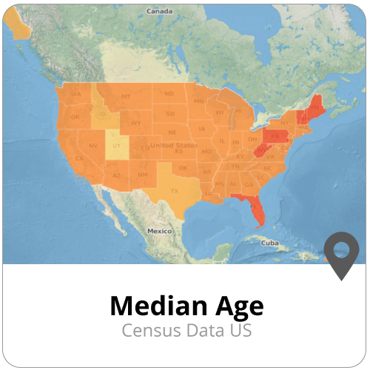
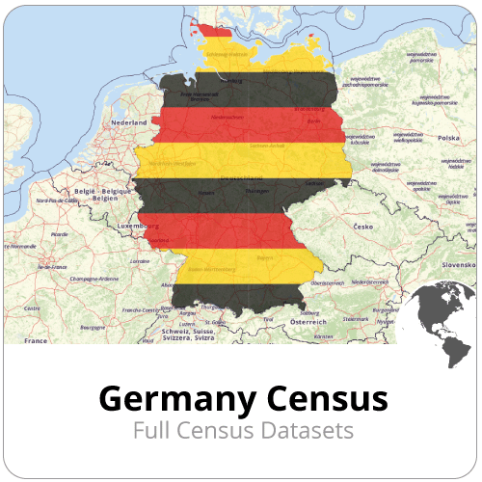
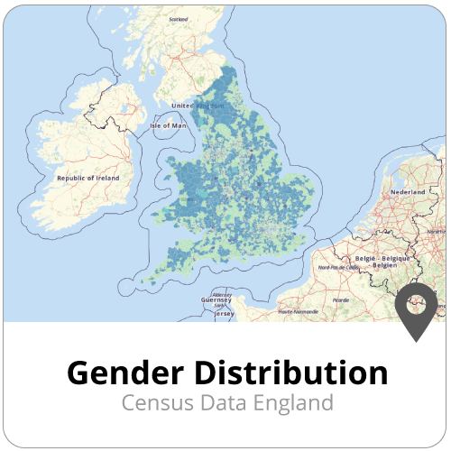
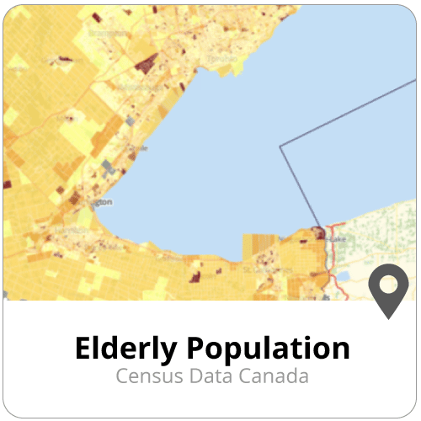
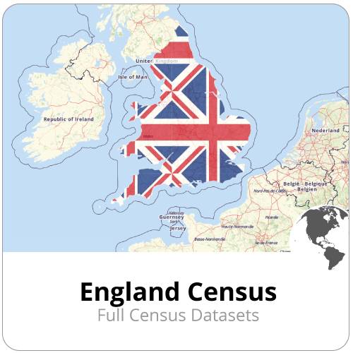
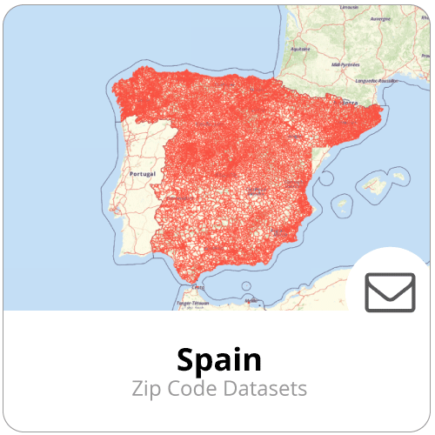
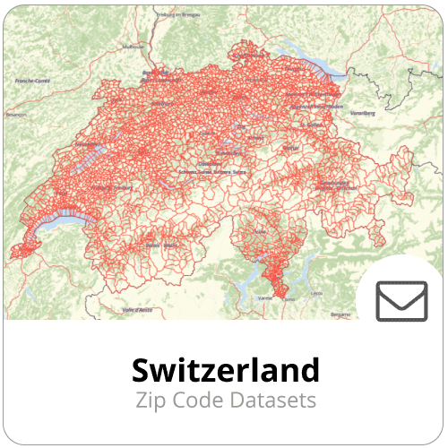
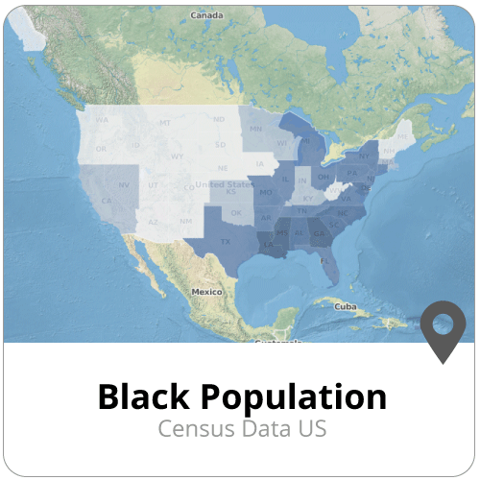
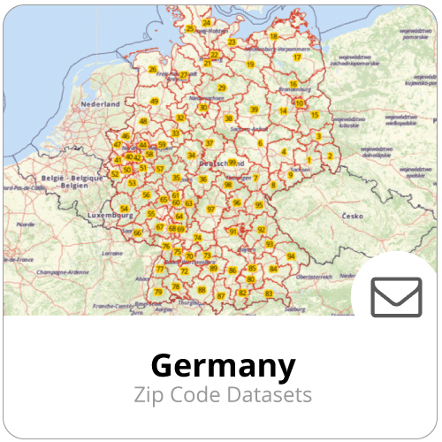
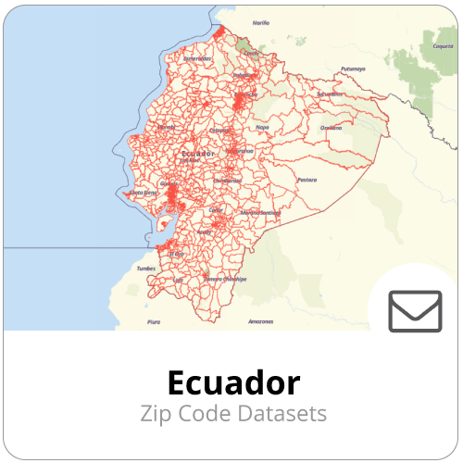
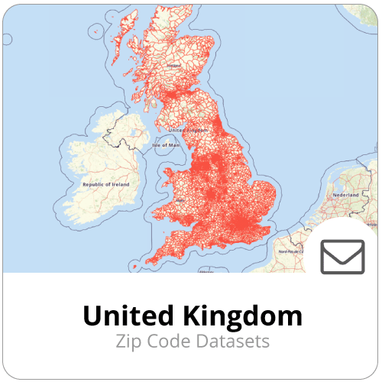
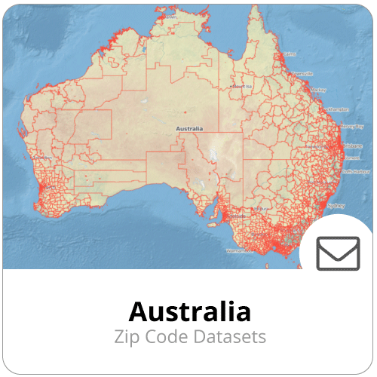
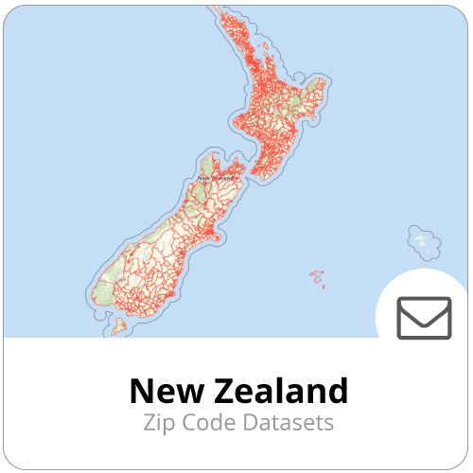








Notes:
4 03:00 03:30 Data of Spotzi
A lot of data

Slide 5
Research Topic #2:
A usable spatial data publication platform
This research topic is about a platform approach for spatial data on the web, making it easy to find and use.
Easy to find
Government as a platform
Community
Some Questions for this topic:
What should a governmental data dissemination platform look like?
How can metadata be made crawlable and indexable by search engines?
How can users be allowed to expand authoritative data?
How can information instead of data be made crawlable?
What can we learn from OpenStreetmap’s data model and search APIs
Notes:
5 03:30 04:30 Research Topic 2
About the topic
Platform approach for spatial data on the web
The goal of this topic
The leading perspective of this research topic is using the data, i.e. the user leading perspective. Its goal is to find out how to make spatial data easy to find and more specifically to explore the idea of ‘government as a platform’ i.e. make data easier to use by providing not only the data itself but also a community surrounding it. Given the fact that now there are disparate data sources full of opaque data, what needs to be done differently and by whom?
Questions for this topic that we need to investigate
What should a governmental data dissemination platform look like?
How can metadata be made crawlable and indexable by search engines?
How can users be allowed to expand authoritative data?
How can information instead of data be made crawlable?
What can we learn from OpenStreetmap’s data model and search APIs

Slide 6




OpenStreetMap
Notes:
6 04:30 05:30 OSM
In recent years OpenStreetMap (OSM) has become an ubiquitous platform for storage, management and extraction of geographical data.
The quality of the data has increased considerably.
An ever growing number of companies is using it to power their innovative geo-services.
OSM’s already rich tooling ecosystem is explanding at a considerable rate as more and more companies and organizations are contributing resources. Finding, querying and downloading data from OpenStreetMap has become straightforward and can be done in many different ways. Plugins that read date from OSM exist for many popular GIS, data visualization tools and client-side frameworks.
The popularity and low barrier of entry to the OSM technology stack raises the question: is it suitable for use as a modern dissemination platform for open data? OSM and the tooling/APIs that surround it provide:
A single/central searchable data store
Input from users: anyone can create adapt, delete and tag objects
History through changesets
Flat file downloads as well as queries through APIs
Lively community and extensive documentation
Rich tooling ecosystem
Each object type has a unique ID and thus could be referred to by a URL

Slide 7
Topic 2
Why did we tender?
What is our approach for this topic?
Notes:
7 05:30 06:00 Why tender
Spotzi and Topic 2
Motivation
Fits us well
Spotzi building a platform that we can use to test with
Experience with end users
Great learning experience
Approach
Using our own platform, based on CartoDB technology
Adjusting the platform for the geonovum project
Good communication with end-users, user is important
Keep it simple

Slide 8
Tasks of the study
User management
Workflows and toolchains
Searchable data
Linking data
Notes:
8 06:00 06:30 ContentsOverview
Quick overview of the presentation. Where are we now and what’s next.
User management
Task 1 – Updating the data.
Workflows and toolchains
Task 2 - Working with existing workflows.
Task 6 - Creating a toolchain that allows non-geo administrators and data owners to publish and maintain information.
Task 7 - Spatial Reference Systems.
Searchable data
Task 3 - Creating a searchable datastore.
Linking data
Task 4 - Working with non-geo data.
Task 5 - Linking the non-geo data (task4) to formal definitions.
Task 8 - Linked Data.
NEXT:
DEMO: 06:30 08:30 Basisfunctionaliteit

Slide 9
User management
Different kind of users
Easy to use
Provide enough functionality
Different authorization levels
View/edit
Propositions
Existing systems
Data quality
Guarantee good quality
Complete, correct and actual data
Indicate the level of quality
Understandable data
What does the data mean?
Aliases
Linked data
Notes:
08:30 11:30 User Management
Whereas the strength of OSM is its crowdsourcing/VGI5 capabilities, authoritative data should not be directly editable by the public. Instead, input from citizens should be checked and approved prior to inclusion. Users should, however, be allowed to tag objects freely as a means of coupling their ontology to that of the authorities. Measures should be taken to address these issues by e.g. implementing:
user-management: authoritative accounts may edit information directly, citizen/user accounts may suggest edits which affect the data only when approved by data owners. No account is needed to read/download data. Data owners can only edit data they own.
two-tier tagging system: ‘authoritative’ tags can only be managed by the dataset’s owner. ‘Community’ tags can be edited by anyone. The latter are meant as a means for users to match their ontology to that of the data owner. Users should be able to search through both sets of tags.
a mechanism through which citizens/users can report errors and suggest changes/update to the data.
To address this issue, Spotzi is creating different authority levels in the platform. We're starting with the following levels:
Visibility:
The data is visible to everyone
The data is visible to a selected group
The data is visible to no one
Editability:
The data is editable by everyone
The data is editable by a selected group
The data is editable by no one
Furthermore we're adding the possibility to work with proposed edits. The Authority of a specific data set can allow others to make proposed edits, but not edit the data source directly.
After speaking with the municipality of Bergen op Zoom we've added some other issues to this task:
A new visibility/editability level: A certain selection of the dataset is visible/editable by a certain user. Example: A user can see the whole dataset but can only edit his own house
An other important thing was the possibility to import authority settings from their own systems. A municipality or other authority already has their own levels of authority restrictions. The platform needs to be able to copy those configurations.
NEXT:
DEMO: 11:30 14:30 AuthorizationLevels

Slide 10
Workflows and toolchains
How to connect with civilians / other users?
Keep it easy
Connect to existing platforms
Find new input (social media)
Use platform to initiate processes
Different ways to connect to the platform
WMS/WFS compatibility
Direct connection to QGIS platform
Notes:
10 14:30 16:30 Workflows
NEXT:
DEMO 16:30 19:30 WMS + QGIS Plugin

Slide 11


Searchable data
OSM’s Overpass API
Search API
Based on SQL
Select, Insert, Update, Delete data
API key
Visualization API
Share maps
Notes:
11 19:30 20:30 Searchable data
NEXT
DEMO: 20:30 25:30 APIS

Slide 12

Linking data
Linking to non-geo data
wiki.openstreetmap.org
Different datasets, not just 1
Linking to formal definitions
unique
basisregistraties
http://definities.geostandaarden.nl/concepten/imgeo/doc/begrip/abri
Versioning
Notes:
12 25:30 27:30 Linked data
NEXT:
DEMO: 27:30 30:00 Information

